Slide 1
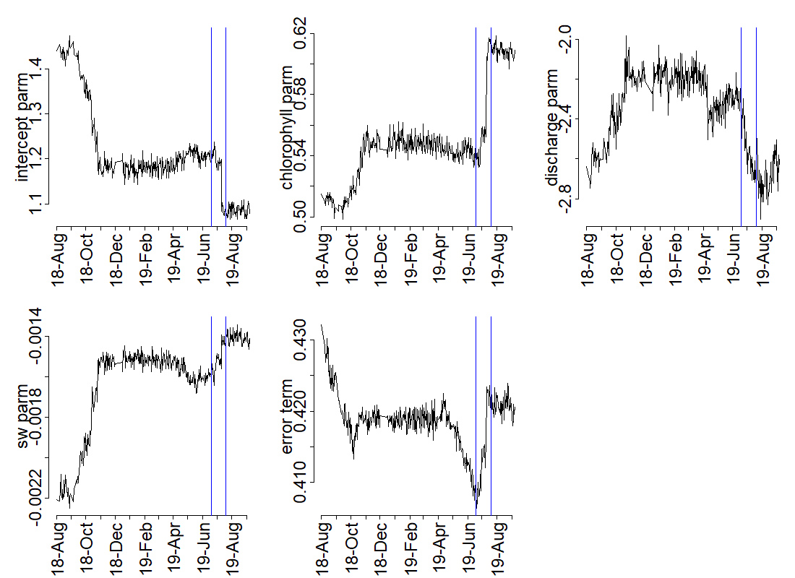
Weekly forecasting: chl_{t} = β₁ + β₂chl_{t-1} + β₃discharge_{t} + β₄sw_mean_{t} + Ɛ

Slide 2
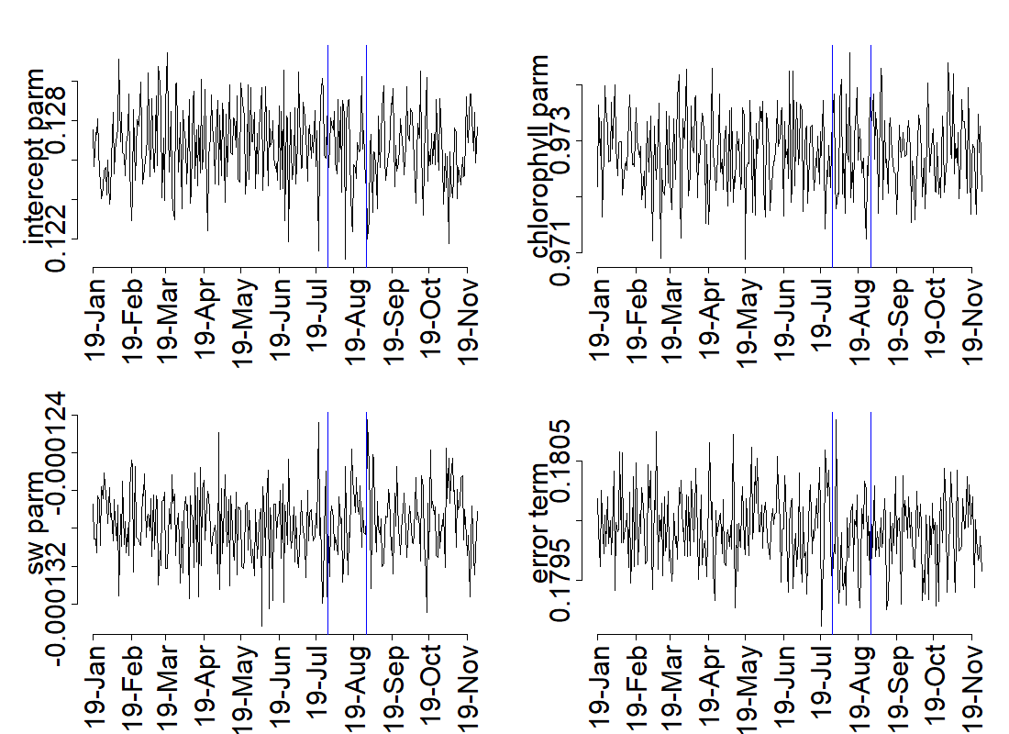
Daily forecasting: chl_{t} = β₁ + β₂chl_{t-1} + β₃sw_mean_{t} + Ɛ

Slide 3
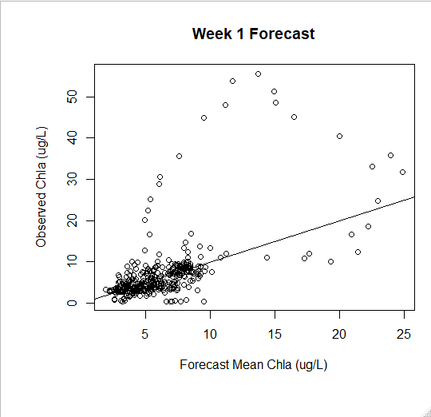
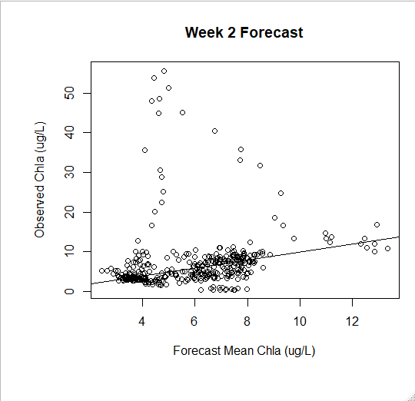

Slide 4
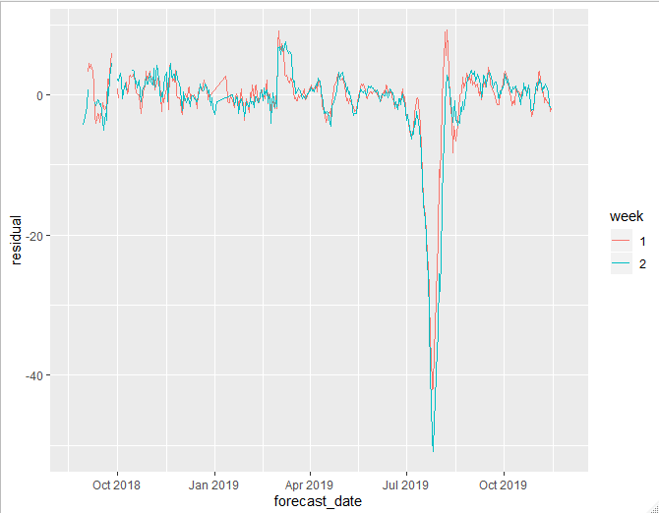

Slide 5
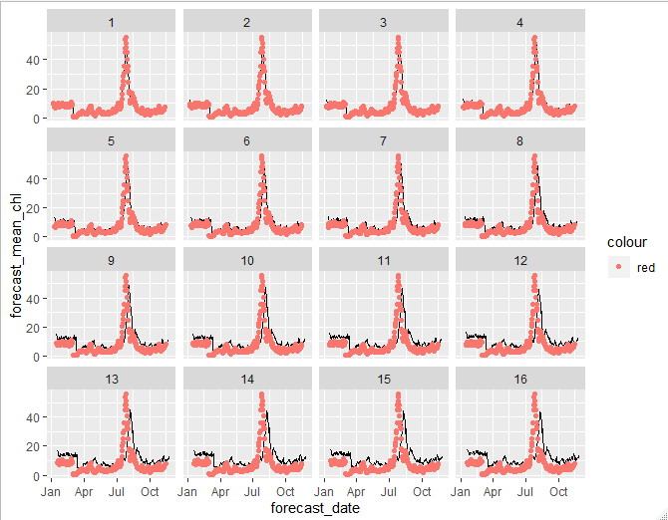

Slide 6
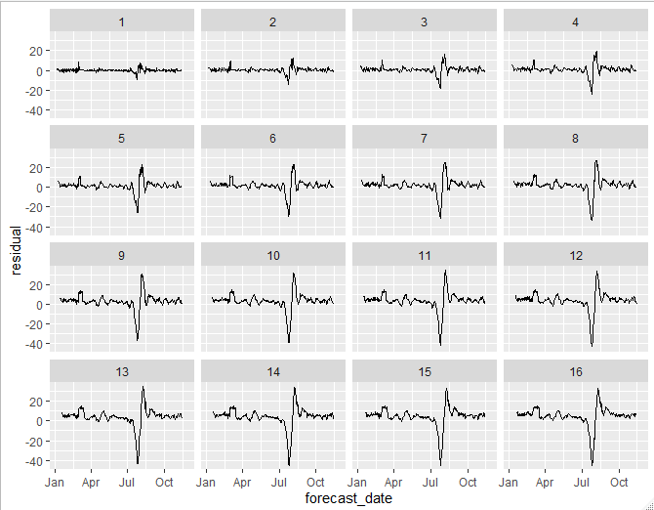

Slide 7
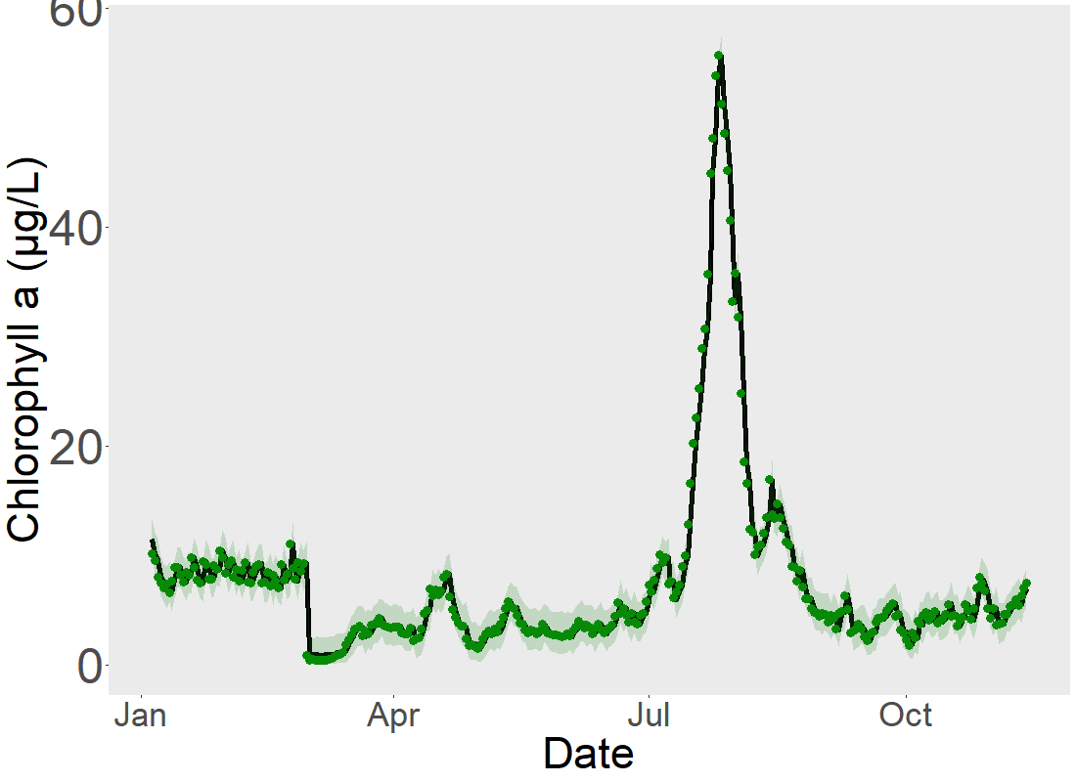
Day 1 forecast with daily model

Slide 8
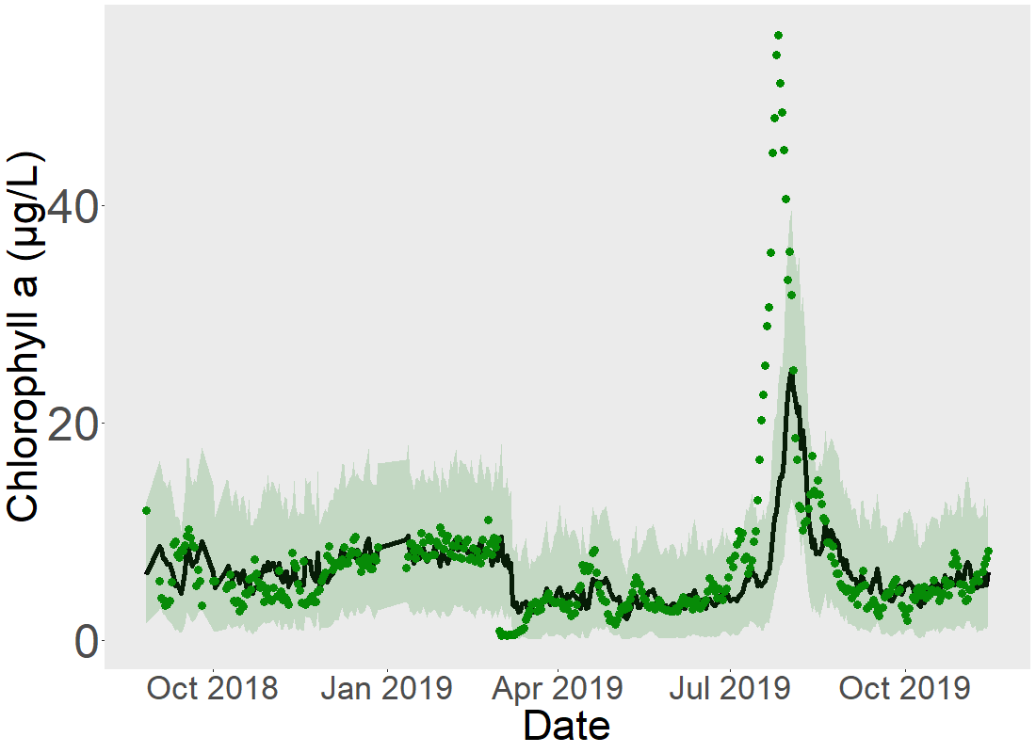
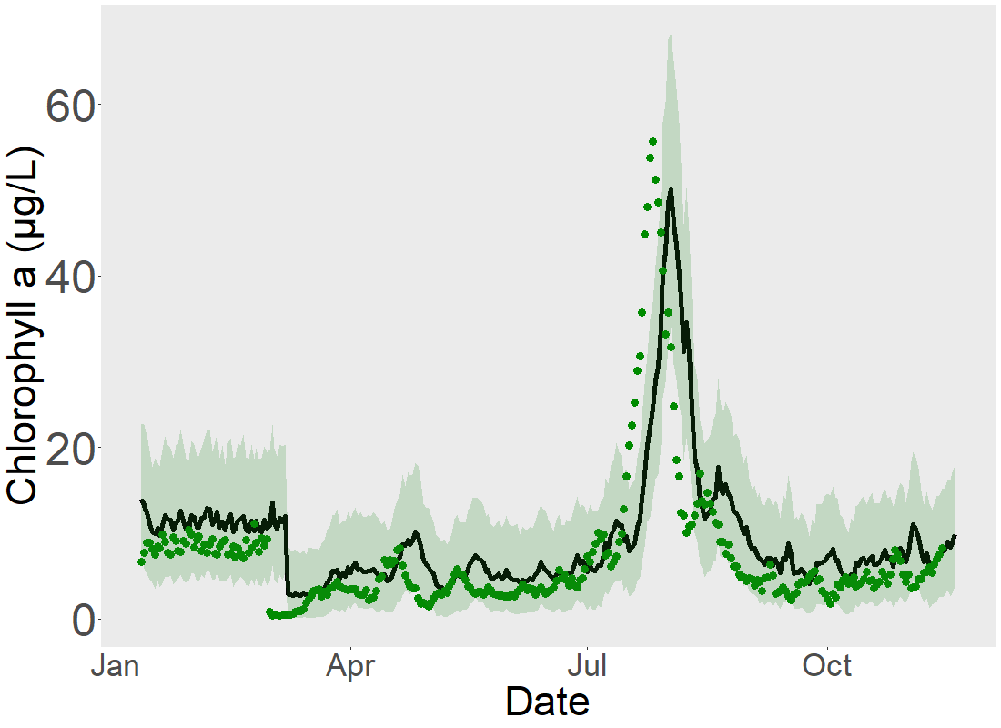
Weekly model does better than 1-week ahead daily model outside of bloom period?
Daily model does better than weekly during bloom, but does not perform better than a null model
Weekly model, 1-week ahead forecast
Daily model, 1-week ahead forecast

